Slide 1
Fitness consultation app
Team Apache Groovy
Ganesh Kumar Rajasekar - G37969806
Prudhvi Lakshmi Sesha Sai Cheedella - G22981341
Sai Nikhil Varada – G43353336
Yashwanth Raj Varadharajan - G47635180

Slide 2
Introduction
We are embarking on a compelling project focused on developing a Fitness Consultation application utilizing Apache Groovy. Clients and Trainers engage in reciprocal interactions in this attempt.
With the use of the application's sign-in/sign-up feature, clients can browse and find trainers according to the services they give. Customers may easily set up appointments, and leave ratings and comments for their respected trainers. The average of the ratings will be the Trainer’s overall rating.
All of the above is within a transaction called ‘consultation’ between the Client and Trainer.
The sign-up and registration process is similarly accessible on the Trainer end. By including specialized activities, trainers can improve their online presence. They keep control over the requests for appointments from clients, choosing whether to accept or politely decline. Creating a vibrant and user-friendly fitness community is the main objective.

Slide 3
Proof of concept
Objective:
To assess the feasibility of creating a fitness consultation application that facilitates communication between clients and trainers.
To validate key features such as user authentication, appointment booking, and feedback.
Development:
Implement a sign-in/sign-up system for both clients and trainers.
Create a simplified user interface for clients to view trainer profiles, book appointments, and provide ratings and feedback.
Authentication and User Profiles:
Users (clients and trainers) can register with basic information (name, email, password).
Authentication ensures secure access to user-specific data.
User profiles are created, including details like fitness goals for clients and areas of specialization for trainers.

Slide 4
Proof of concept
Appointment Booking:
Clients can view trainer profiles, check their availability, and book appointments.
Trainers receive notification of appointment requests and can accept or propose alternative times.
Rating and Feedback:
Clients can rate trainers and provide feedback after each session.
Trainers can view their ratings and feedback to track performance and make improvements.
Trainer Control:
Trainers have the ability to list their specialized activities (e.g., yoga, weightlifting, cardio).
Trainers can set their availability and block off times when they are unavailable for appointments.
Feedback and Iteration:
Clients can rate the trainers for the service they provide.
The average rating of the Trainer will be displayed on the Trainers page.
Decision:
Based on the success of the proof of concept, decide whether to proceed with full-scale development.
Assess the technical feasibility, user satisfaction, and any necessary adjustments or additional features required.

Slide 5






Setup
Required Installation
IntelliJ IDEA
JDK Version 17
MySQL
DataGrip
Postman

Slide 6
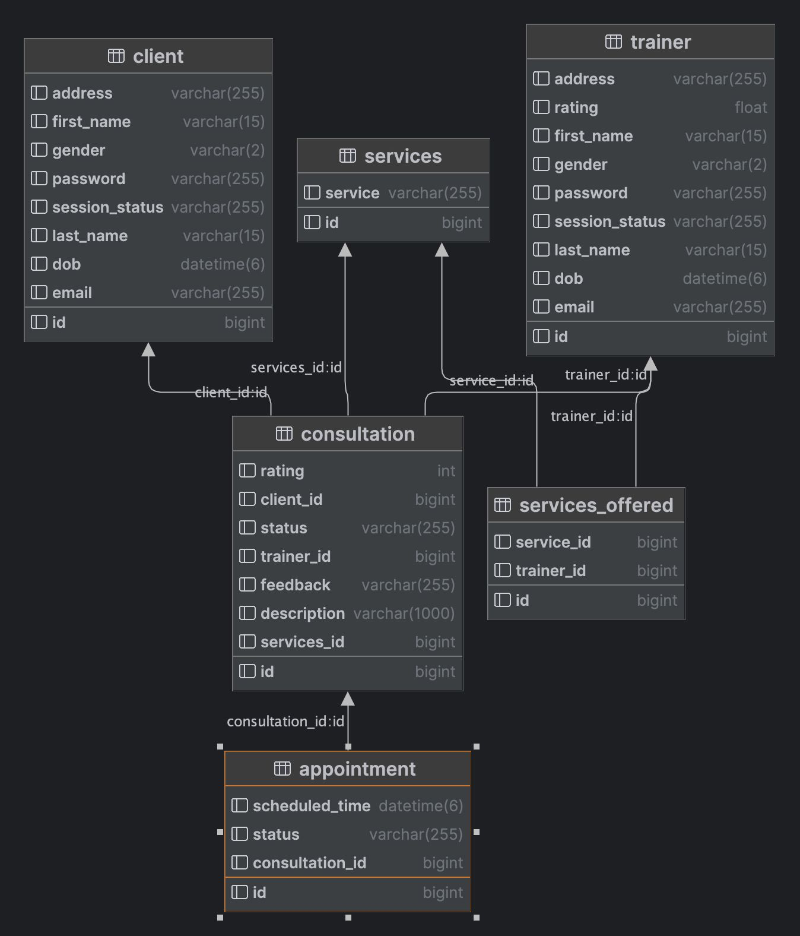

Implementation
In this Application, Client and trainer can sign in/sign up. After registration, trainers can select the services they provide. This can be viewed by clients, and they can request the required service from selected trainers. They can communicate and confirm appointment based on their availability. Once services are utilized, they can log out.

Slide 7
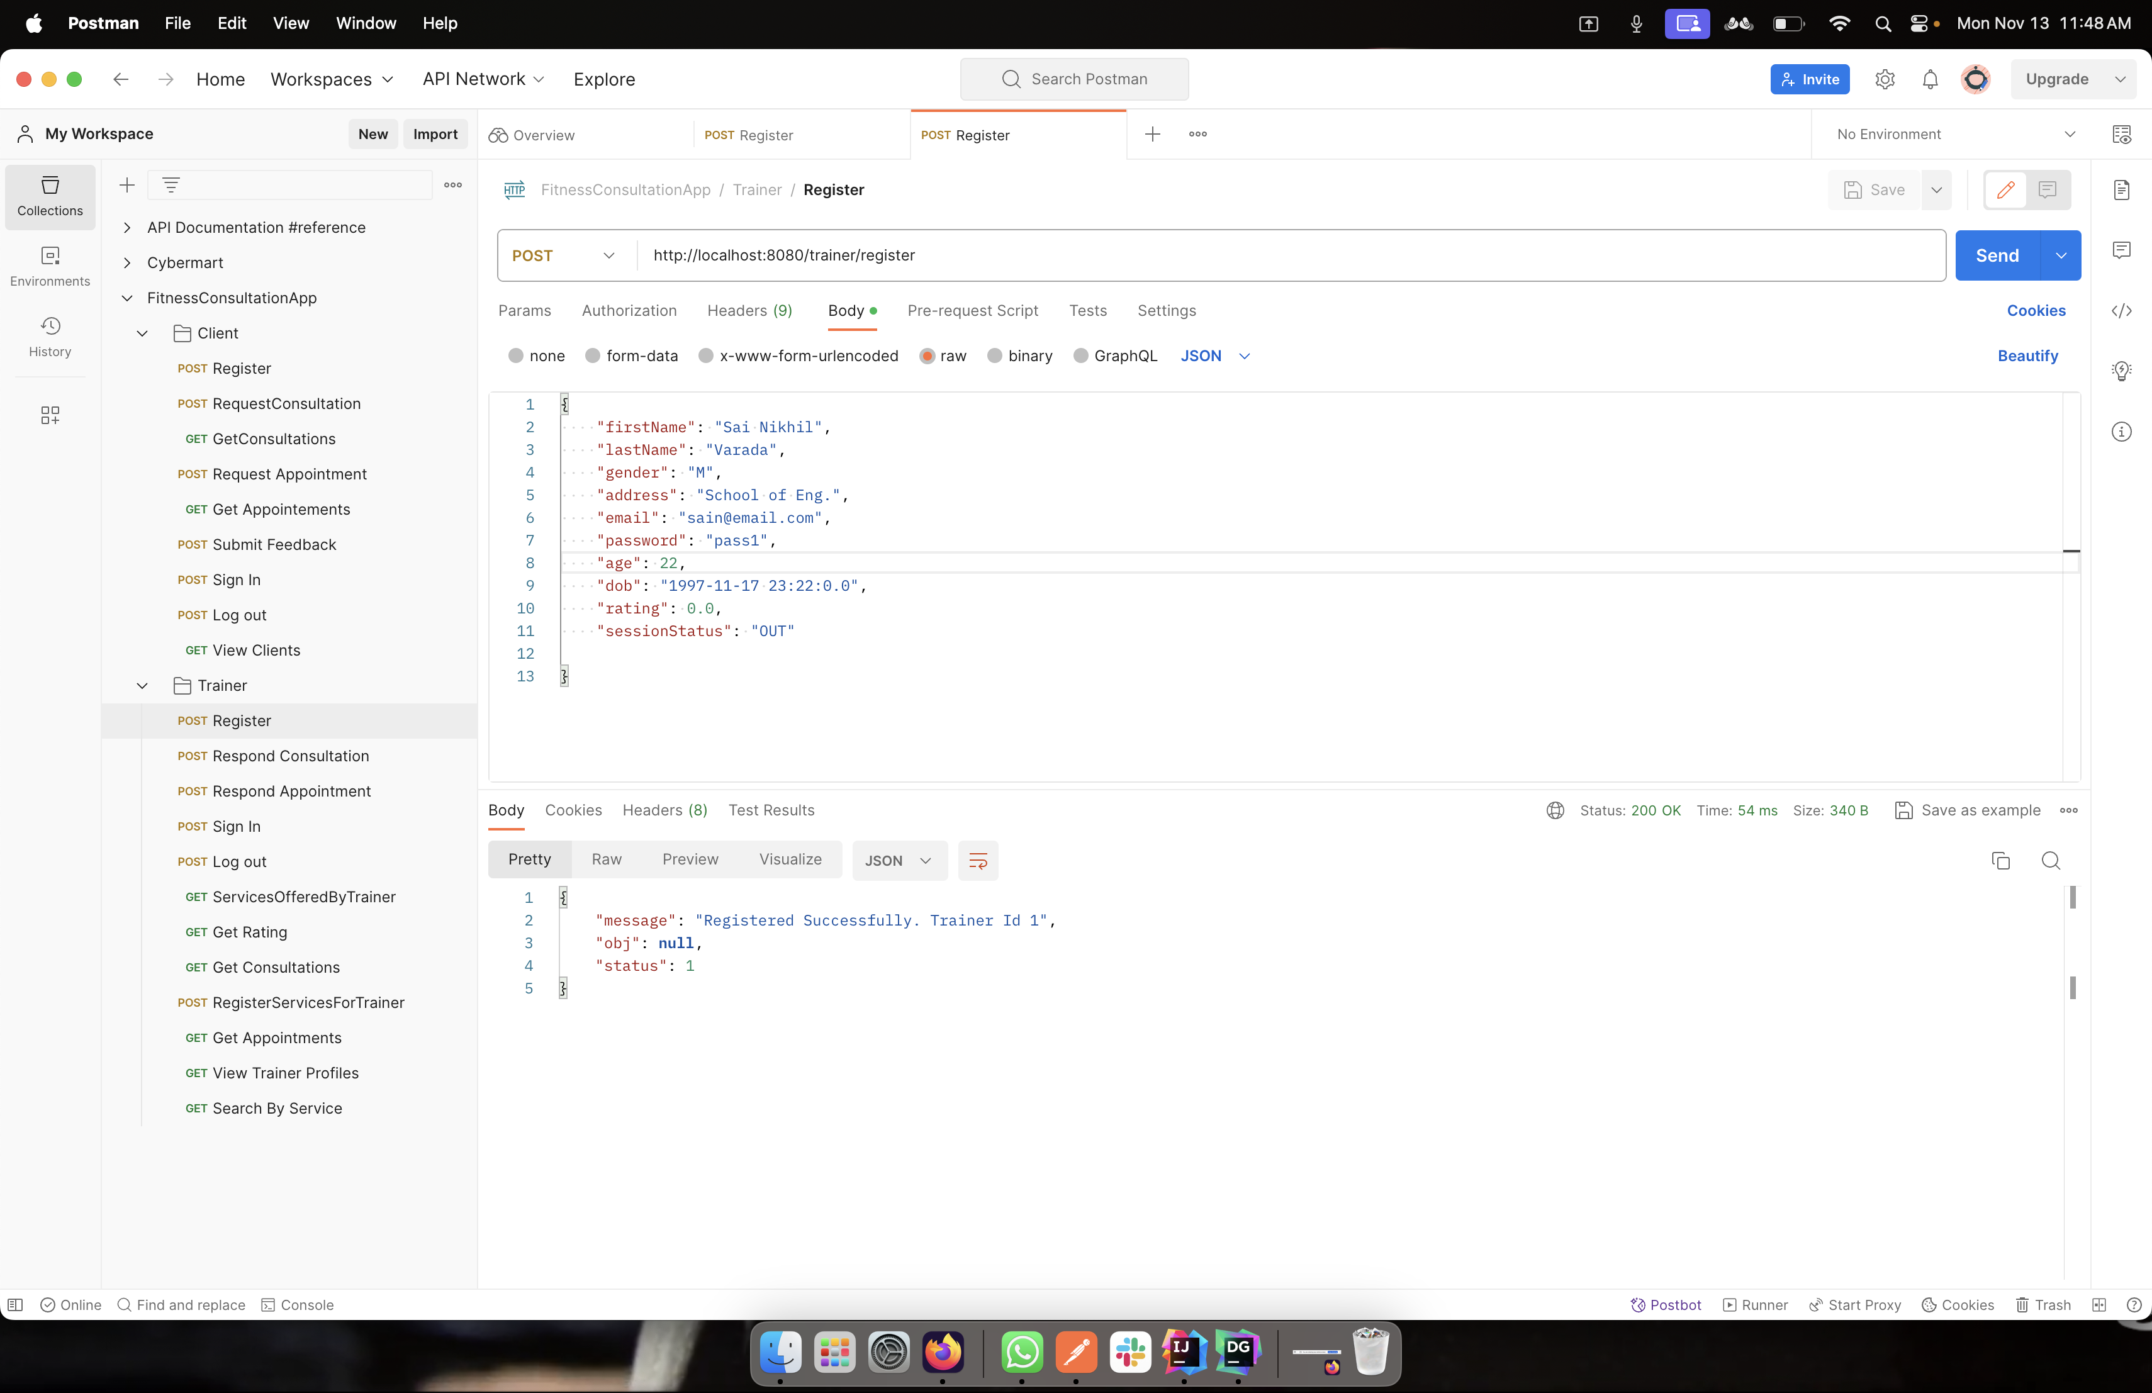
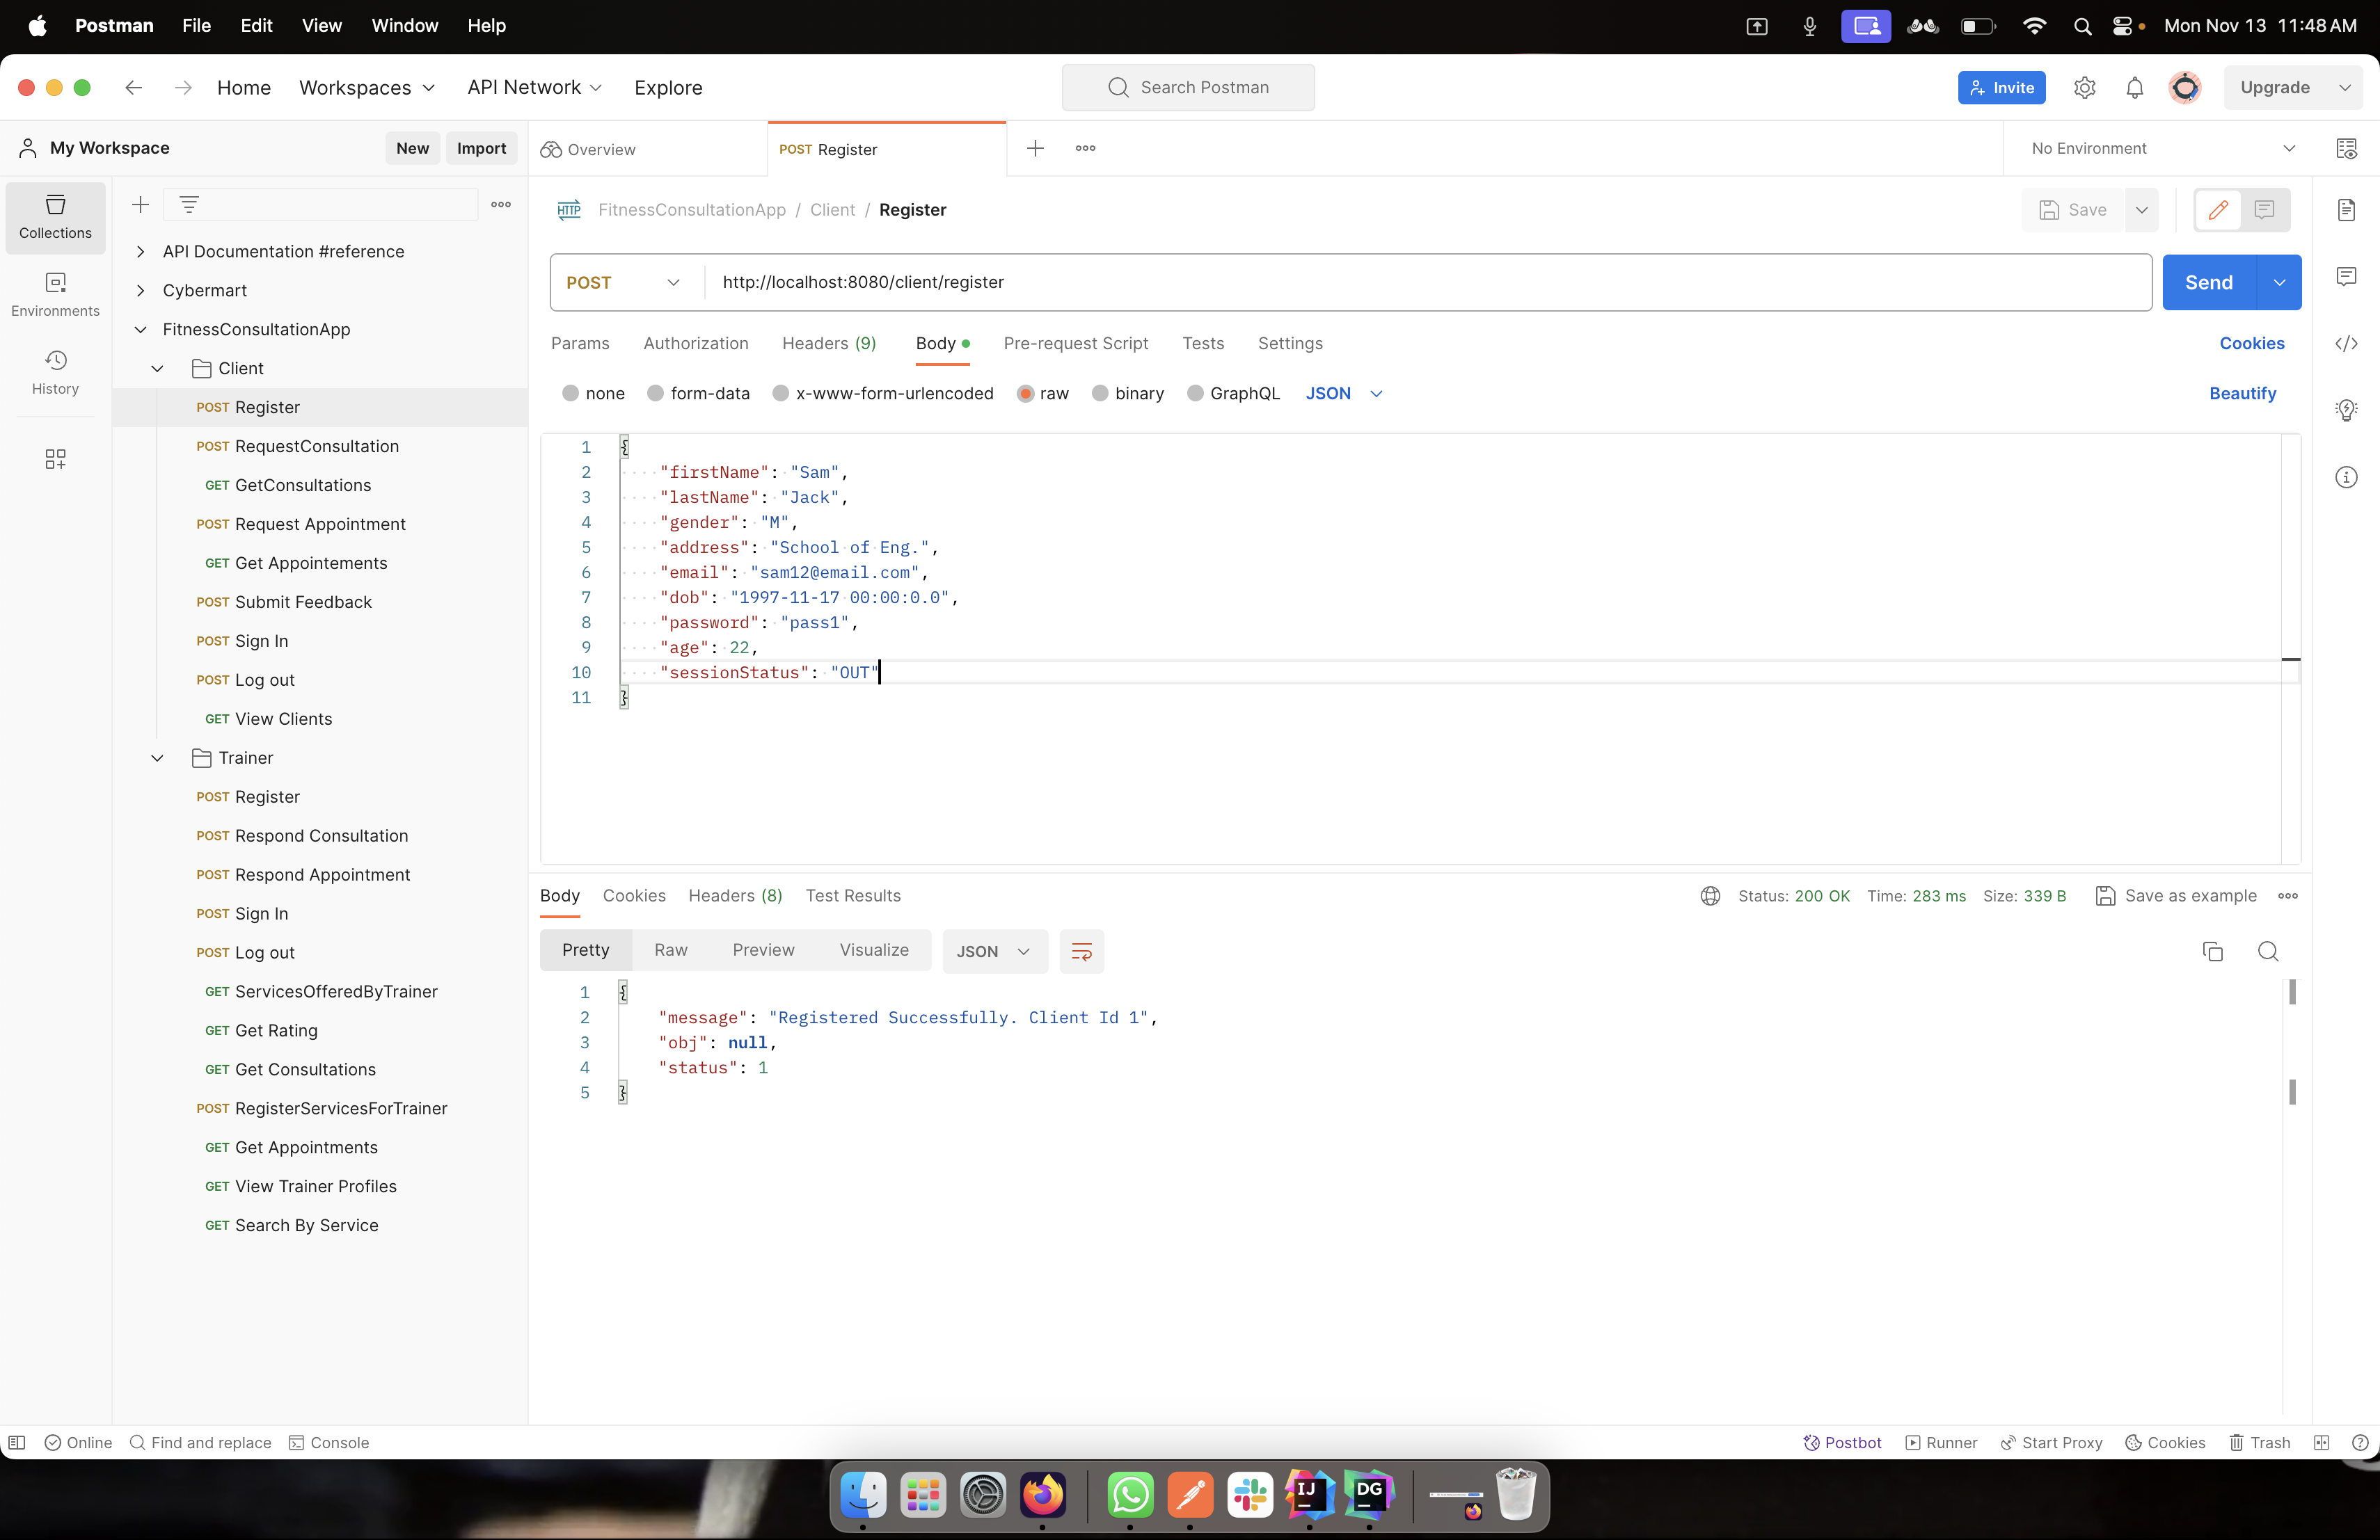
New user registration
When a new Client registers, information like name, gender, address, email, dob and password are recorded.
When new Trainer registers, information like name, gender, address, email, dob, and password are recorded. Rating is set to Zero for new user .

Slide 8
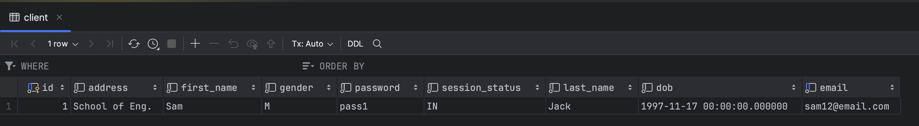
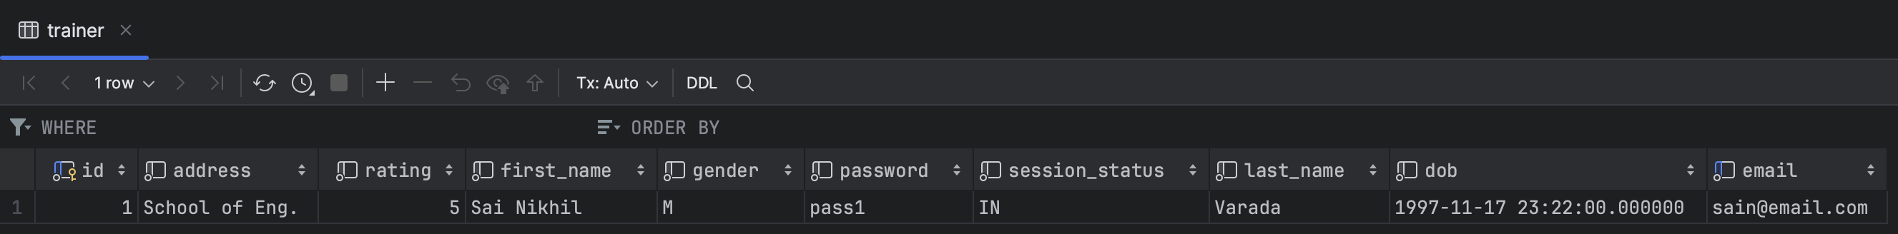
Database with the client and trainer registration info

Slide 9
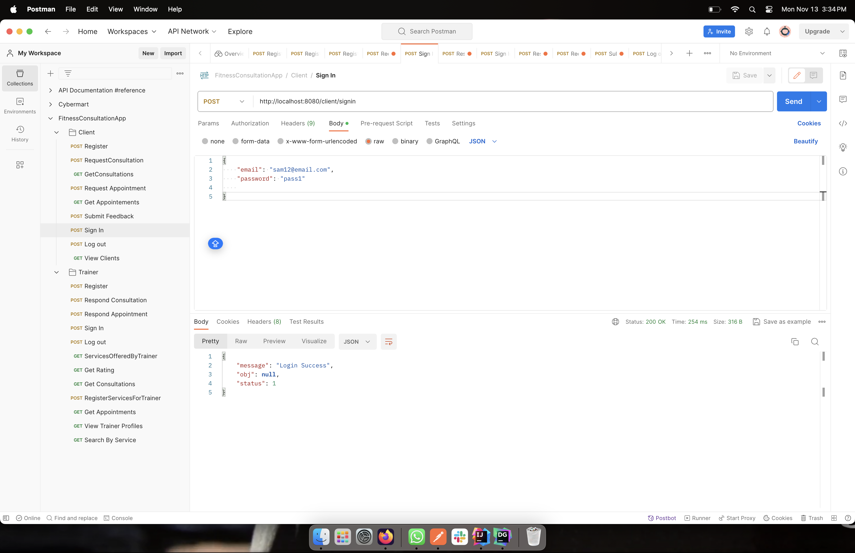
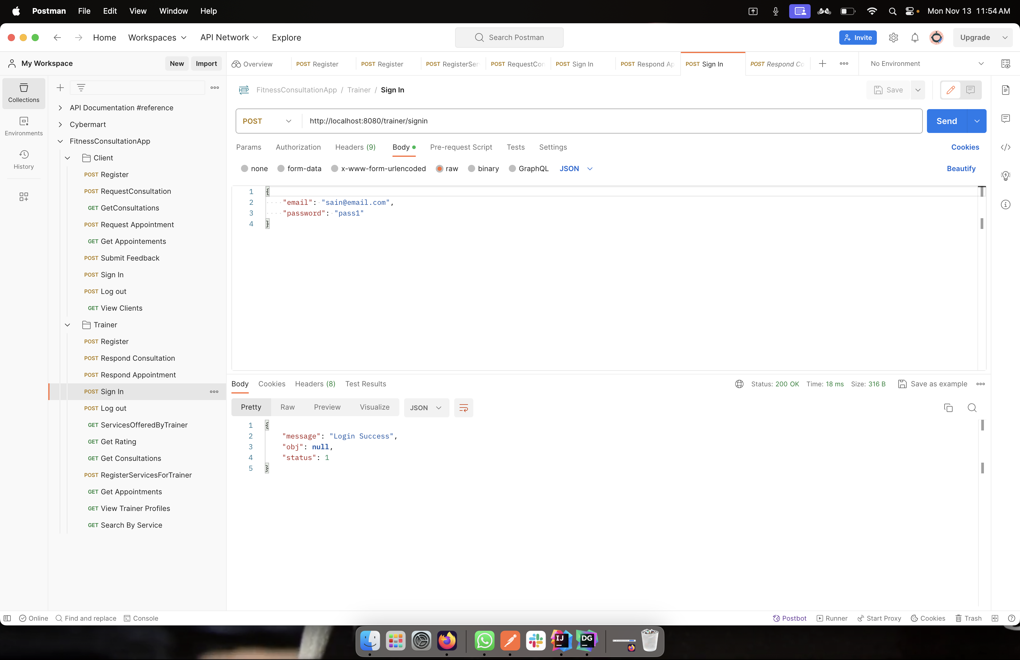
log in
Both the client and the trainer log in using the login credentials they entered during registration.
Users can access the functions only after logging in.

Slide 10
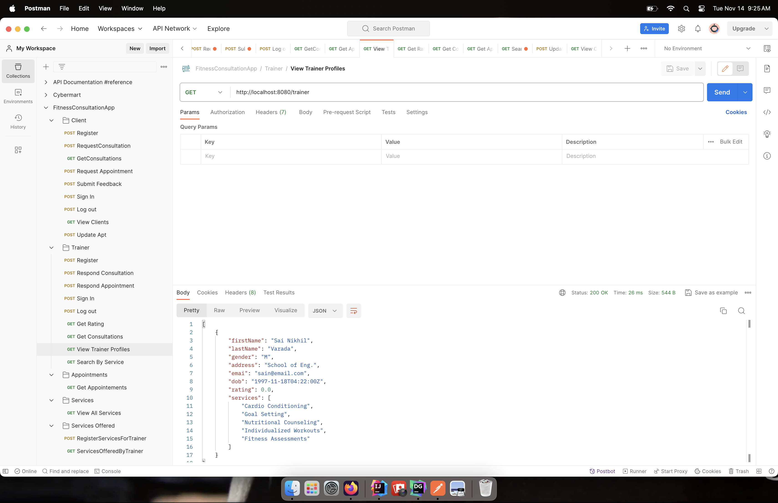
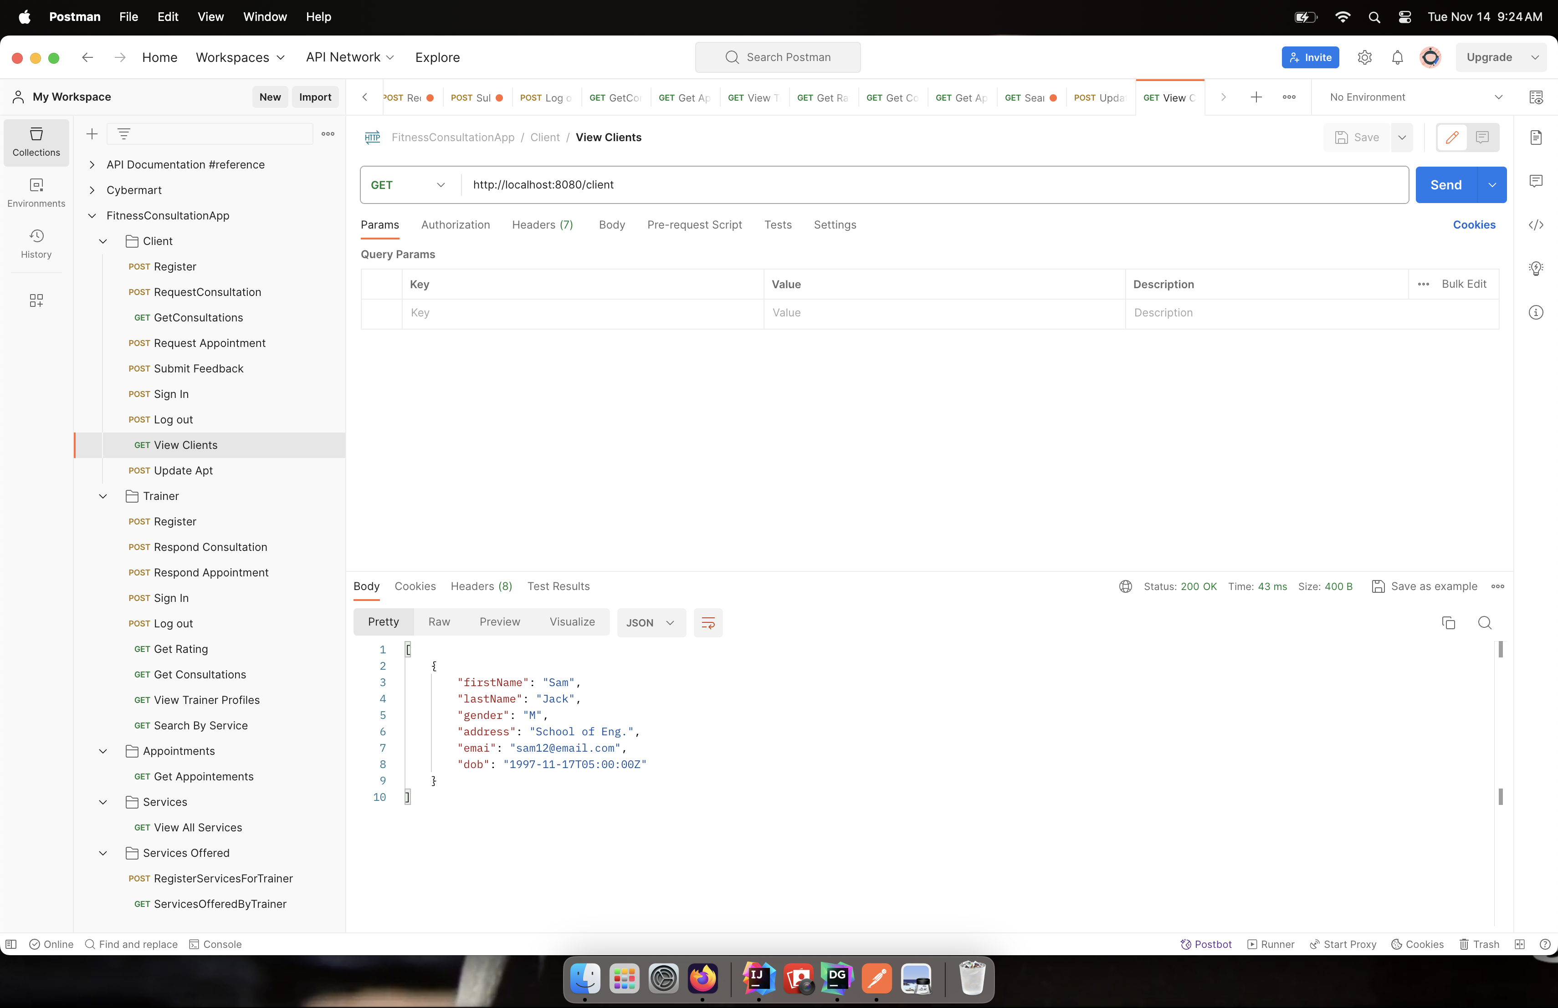
View profile
We can view profile information of Client and Trainer.

Slide 11

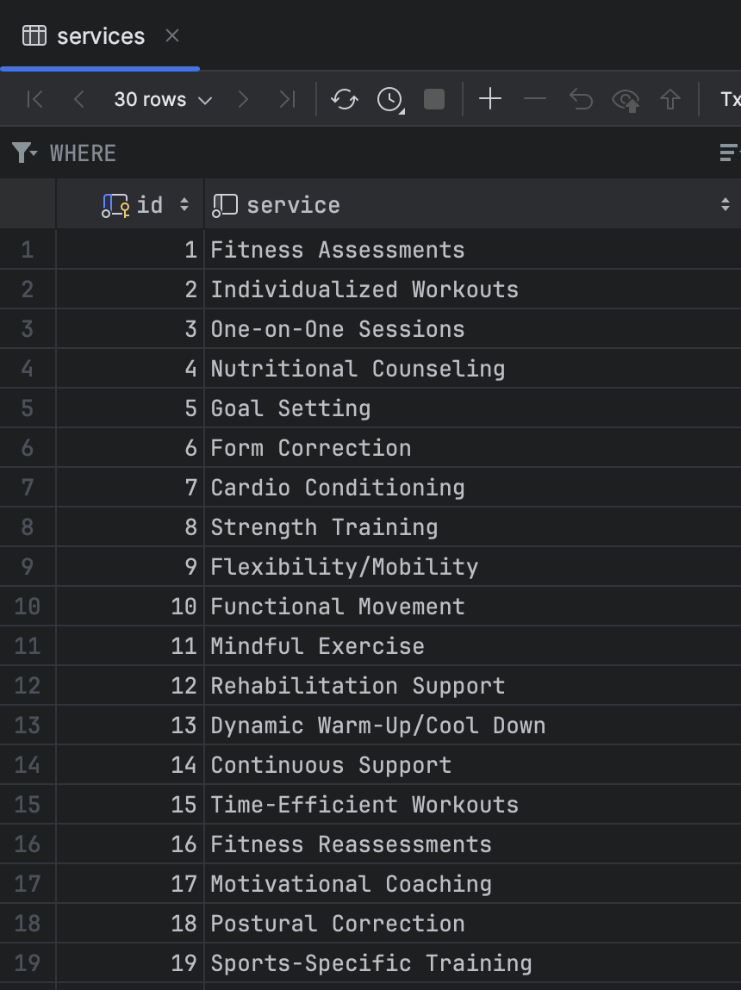
Register for services - trainer
The trainer must choose the services they want to offer after logging in. The services that the trainer has chosen are represented by service IDs, and trainers are referenced by the trainer ID.

Slide 12
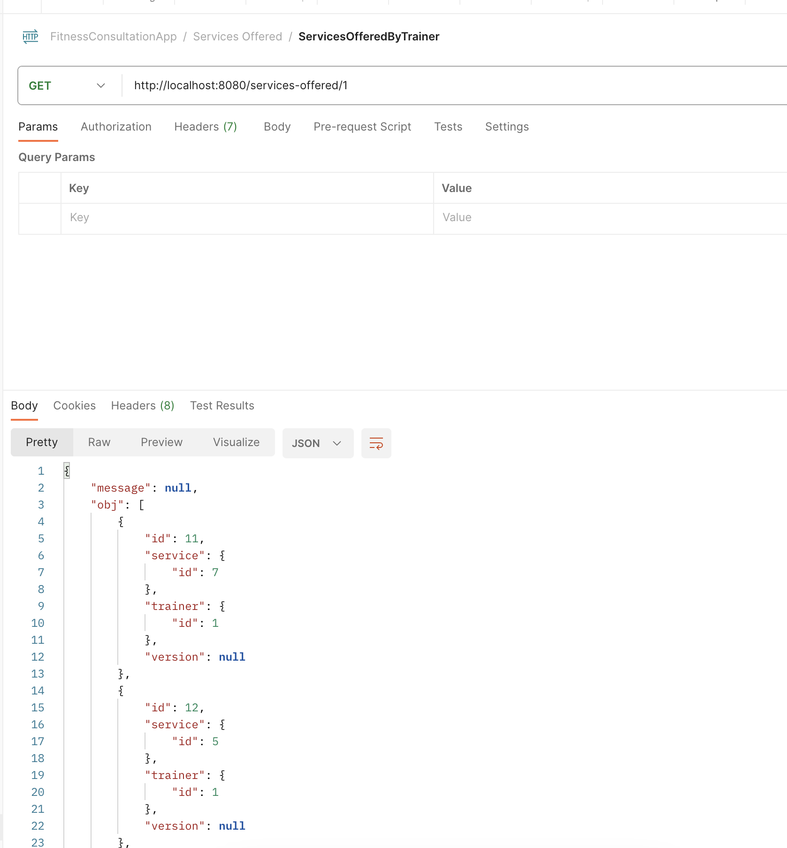
Services offered
Users can view all the available services that are offered by trainers.

Slide 13
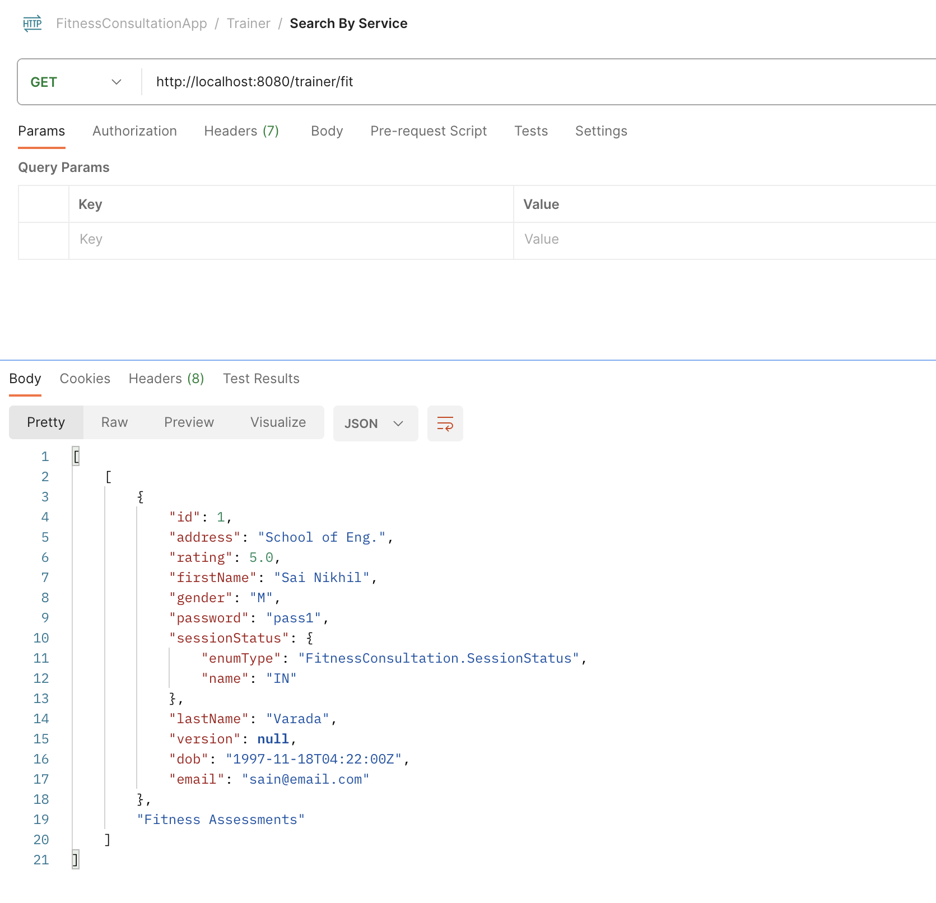
Search by service
Users have the option to search the services offered and then select the trainer providing that service.

Slide 14
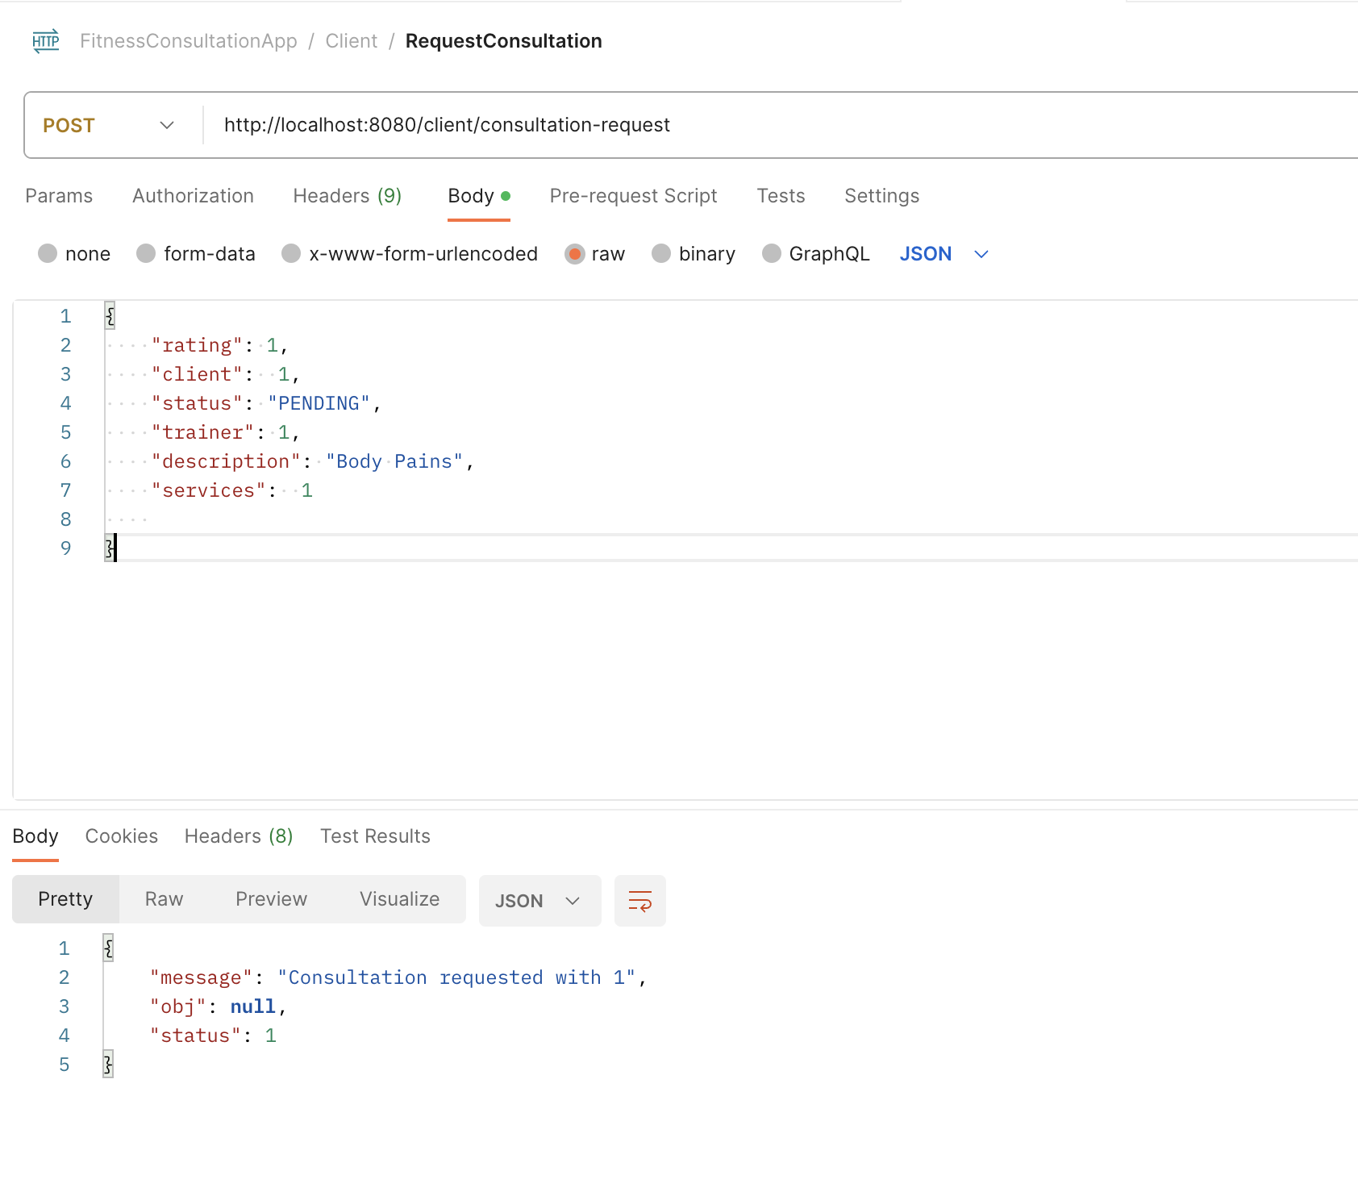
Client request consultation
Once the trainer logs in his available services, the clients can view and select the service they want to use. The client can send a request to the trainer who provides the desired service.

Slide 15

Trainer response consultation
When clients select and request a trainer for a service, the request is forwarded to the trainer, who can accept or reject it.

Slide 16
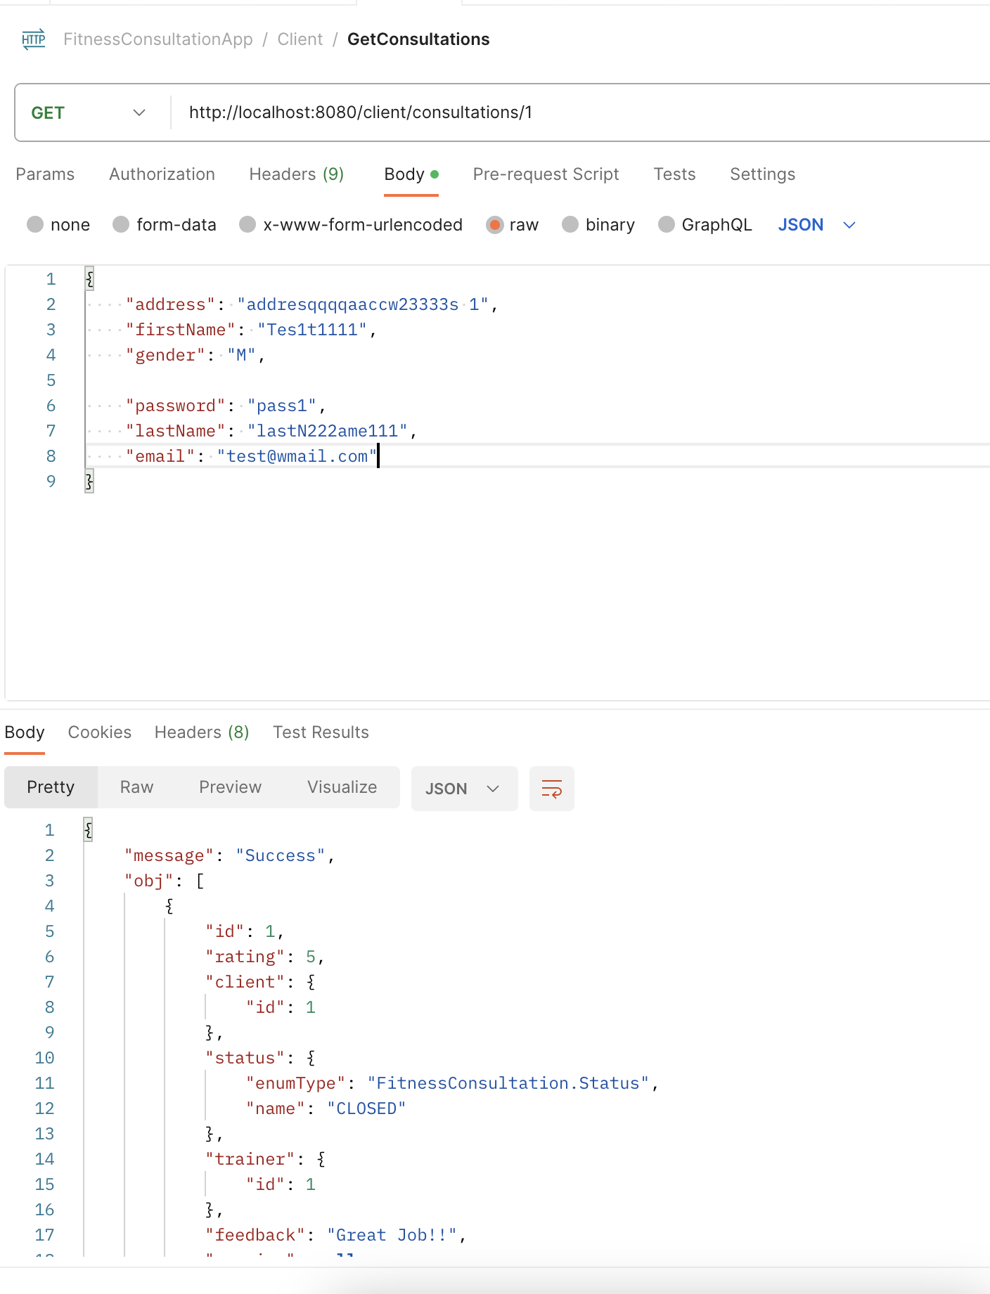
Consultation details
With this API, we can view the consultation information which is referenced with consultation ID, and Trainer and a Service ID.

Slide 17
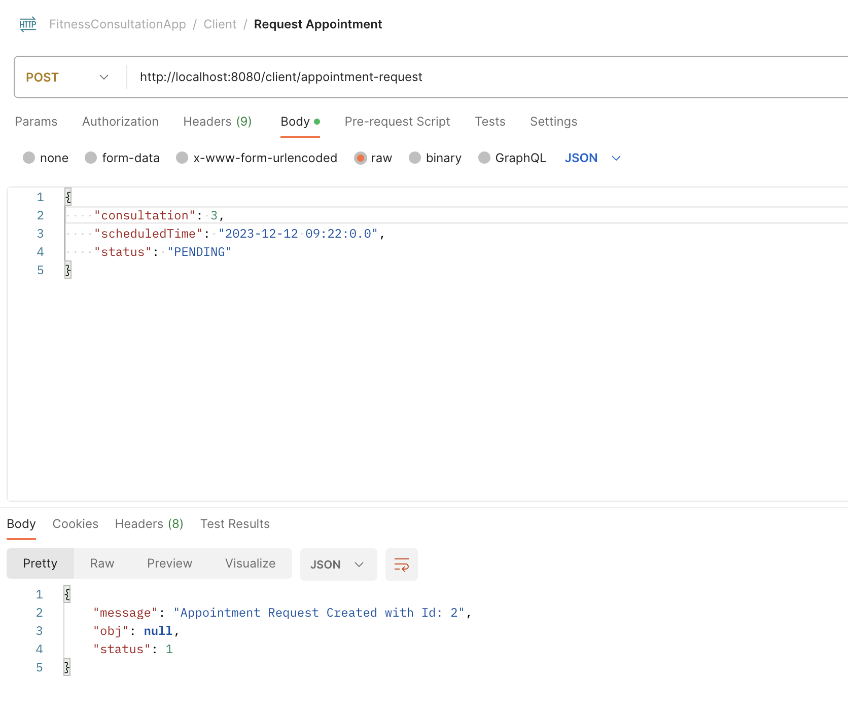
Client request appointment
Once the trainer has accepted the consultation request, the client can specify the day and time of the appointment.

Slide 18
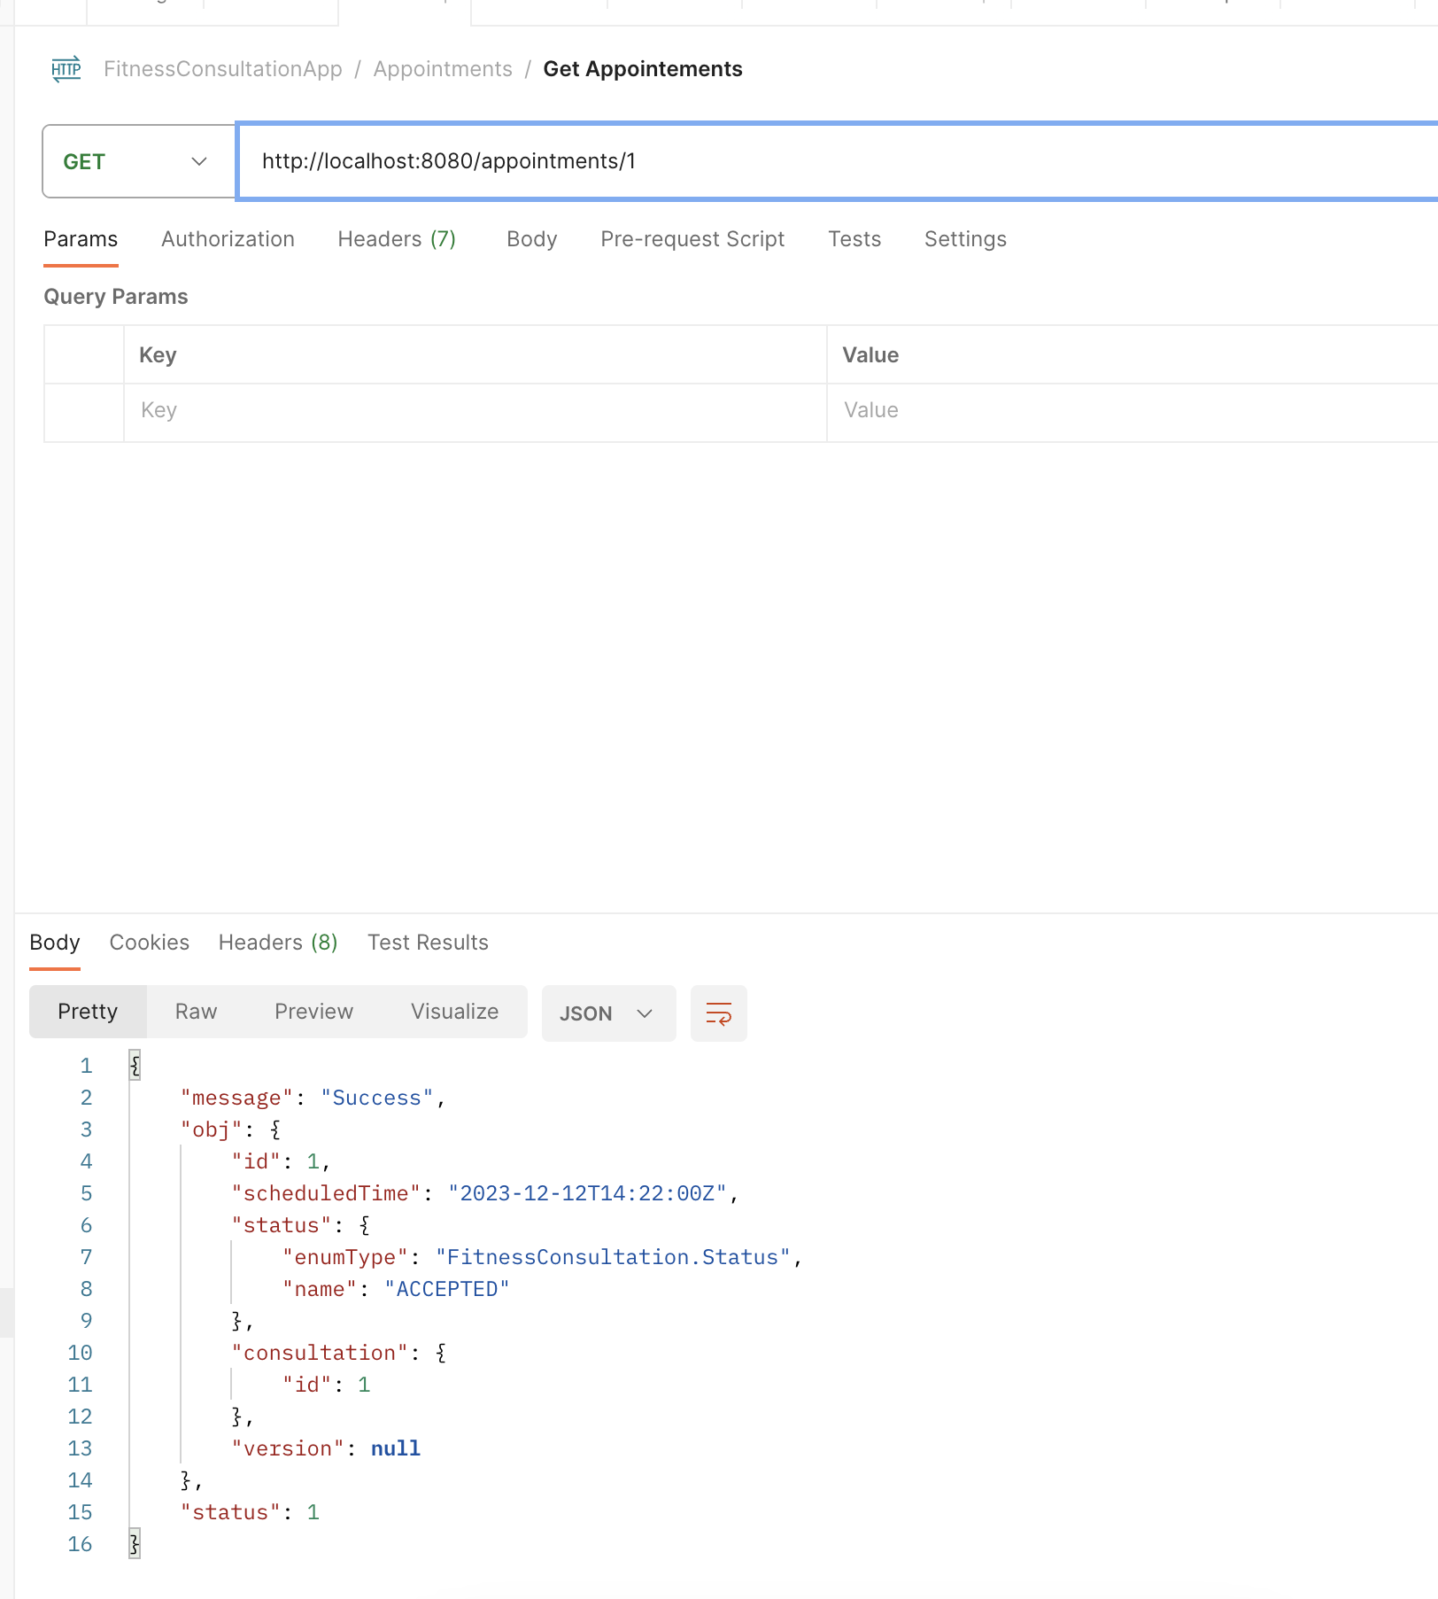
View Appointments
The users can view the requests and status of the appointments.

Slide 19

Trainer fixes appointment
The trainer can make a decision based on their availability at the day and time specified by the client after receiving the appointment request, which is confirmed by the trainer ID and Appointment ID.

Slide 20
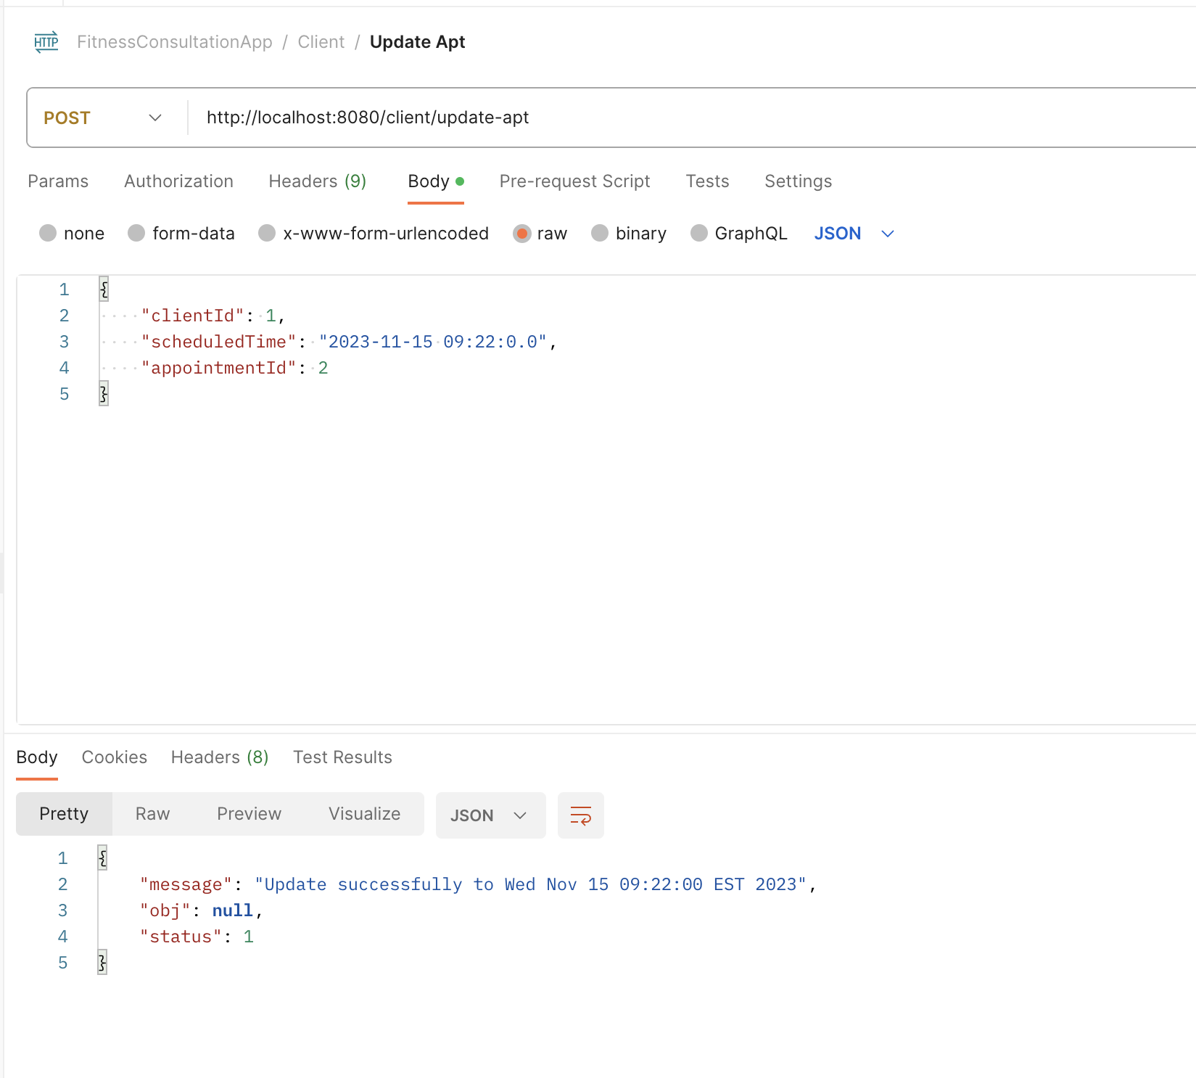
Update appointment
If necessary, the customer can change the scheduling and date of the appointment.

Slide 21
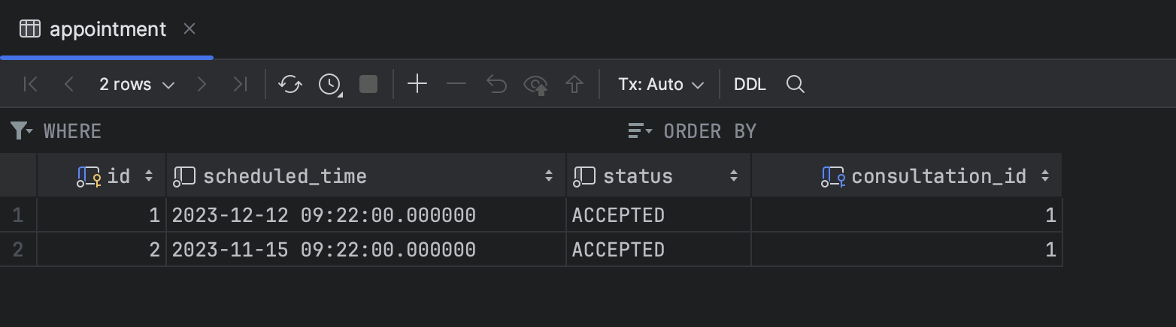
Database once appointment is confirmed
We can see that the database is updated with all of the necessary information about the appointment, which is referenced by the appointment ID and Consultation ID.

Slide 22
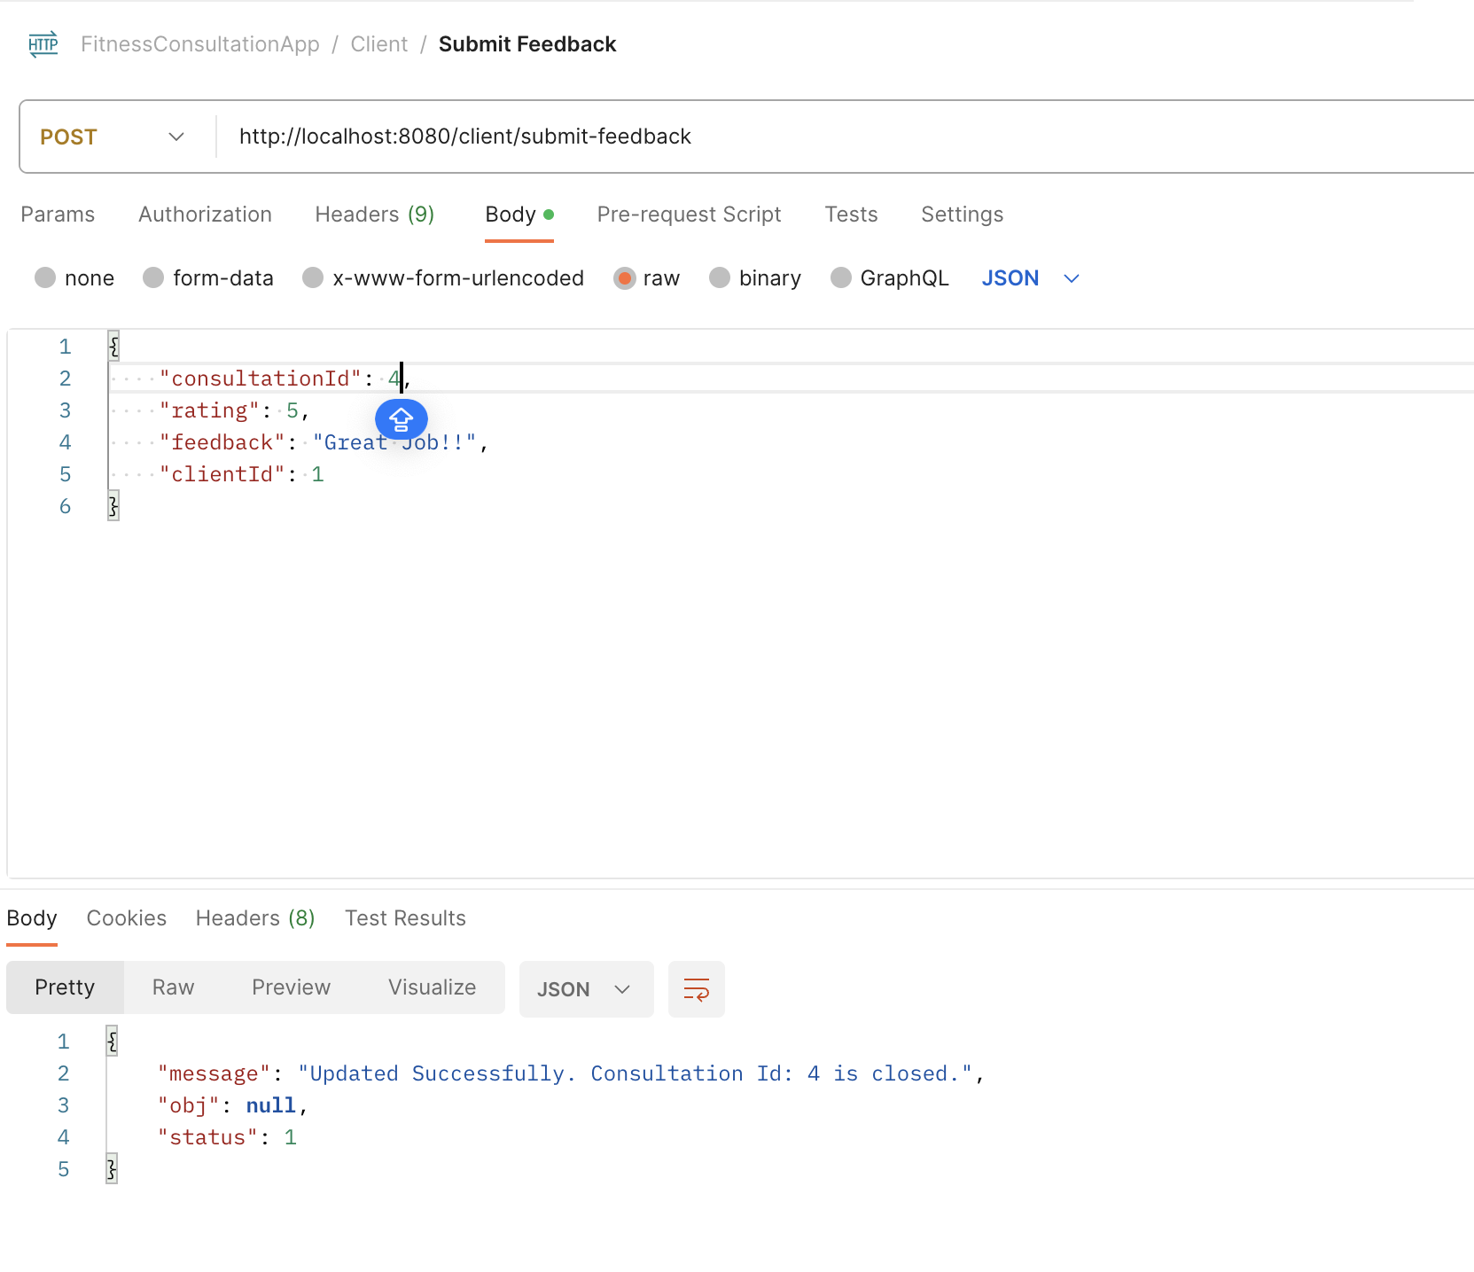
Feedback and Consultation closed
When the required service is performed, the consultation linked by the ID will be closed, indicating that the service has been completed.
Once the service is performed, the client can provide feedback.

Slide 23
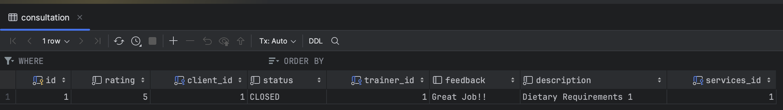
Database after consultation closed
We can observe that once the consultation is over, the status switches to closed. The client gives a rating based on the trainer's consulting service.

Slide 24
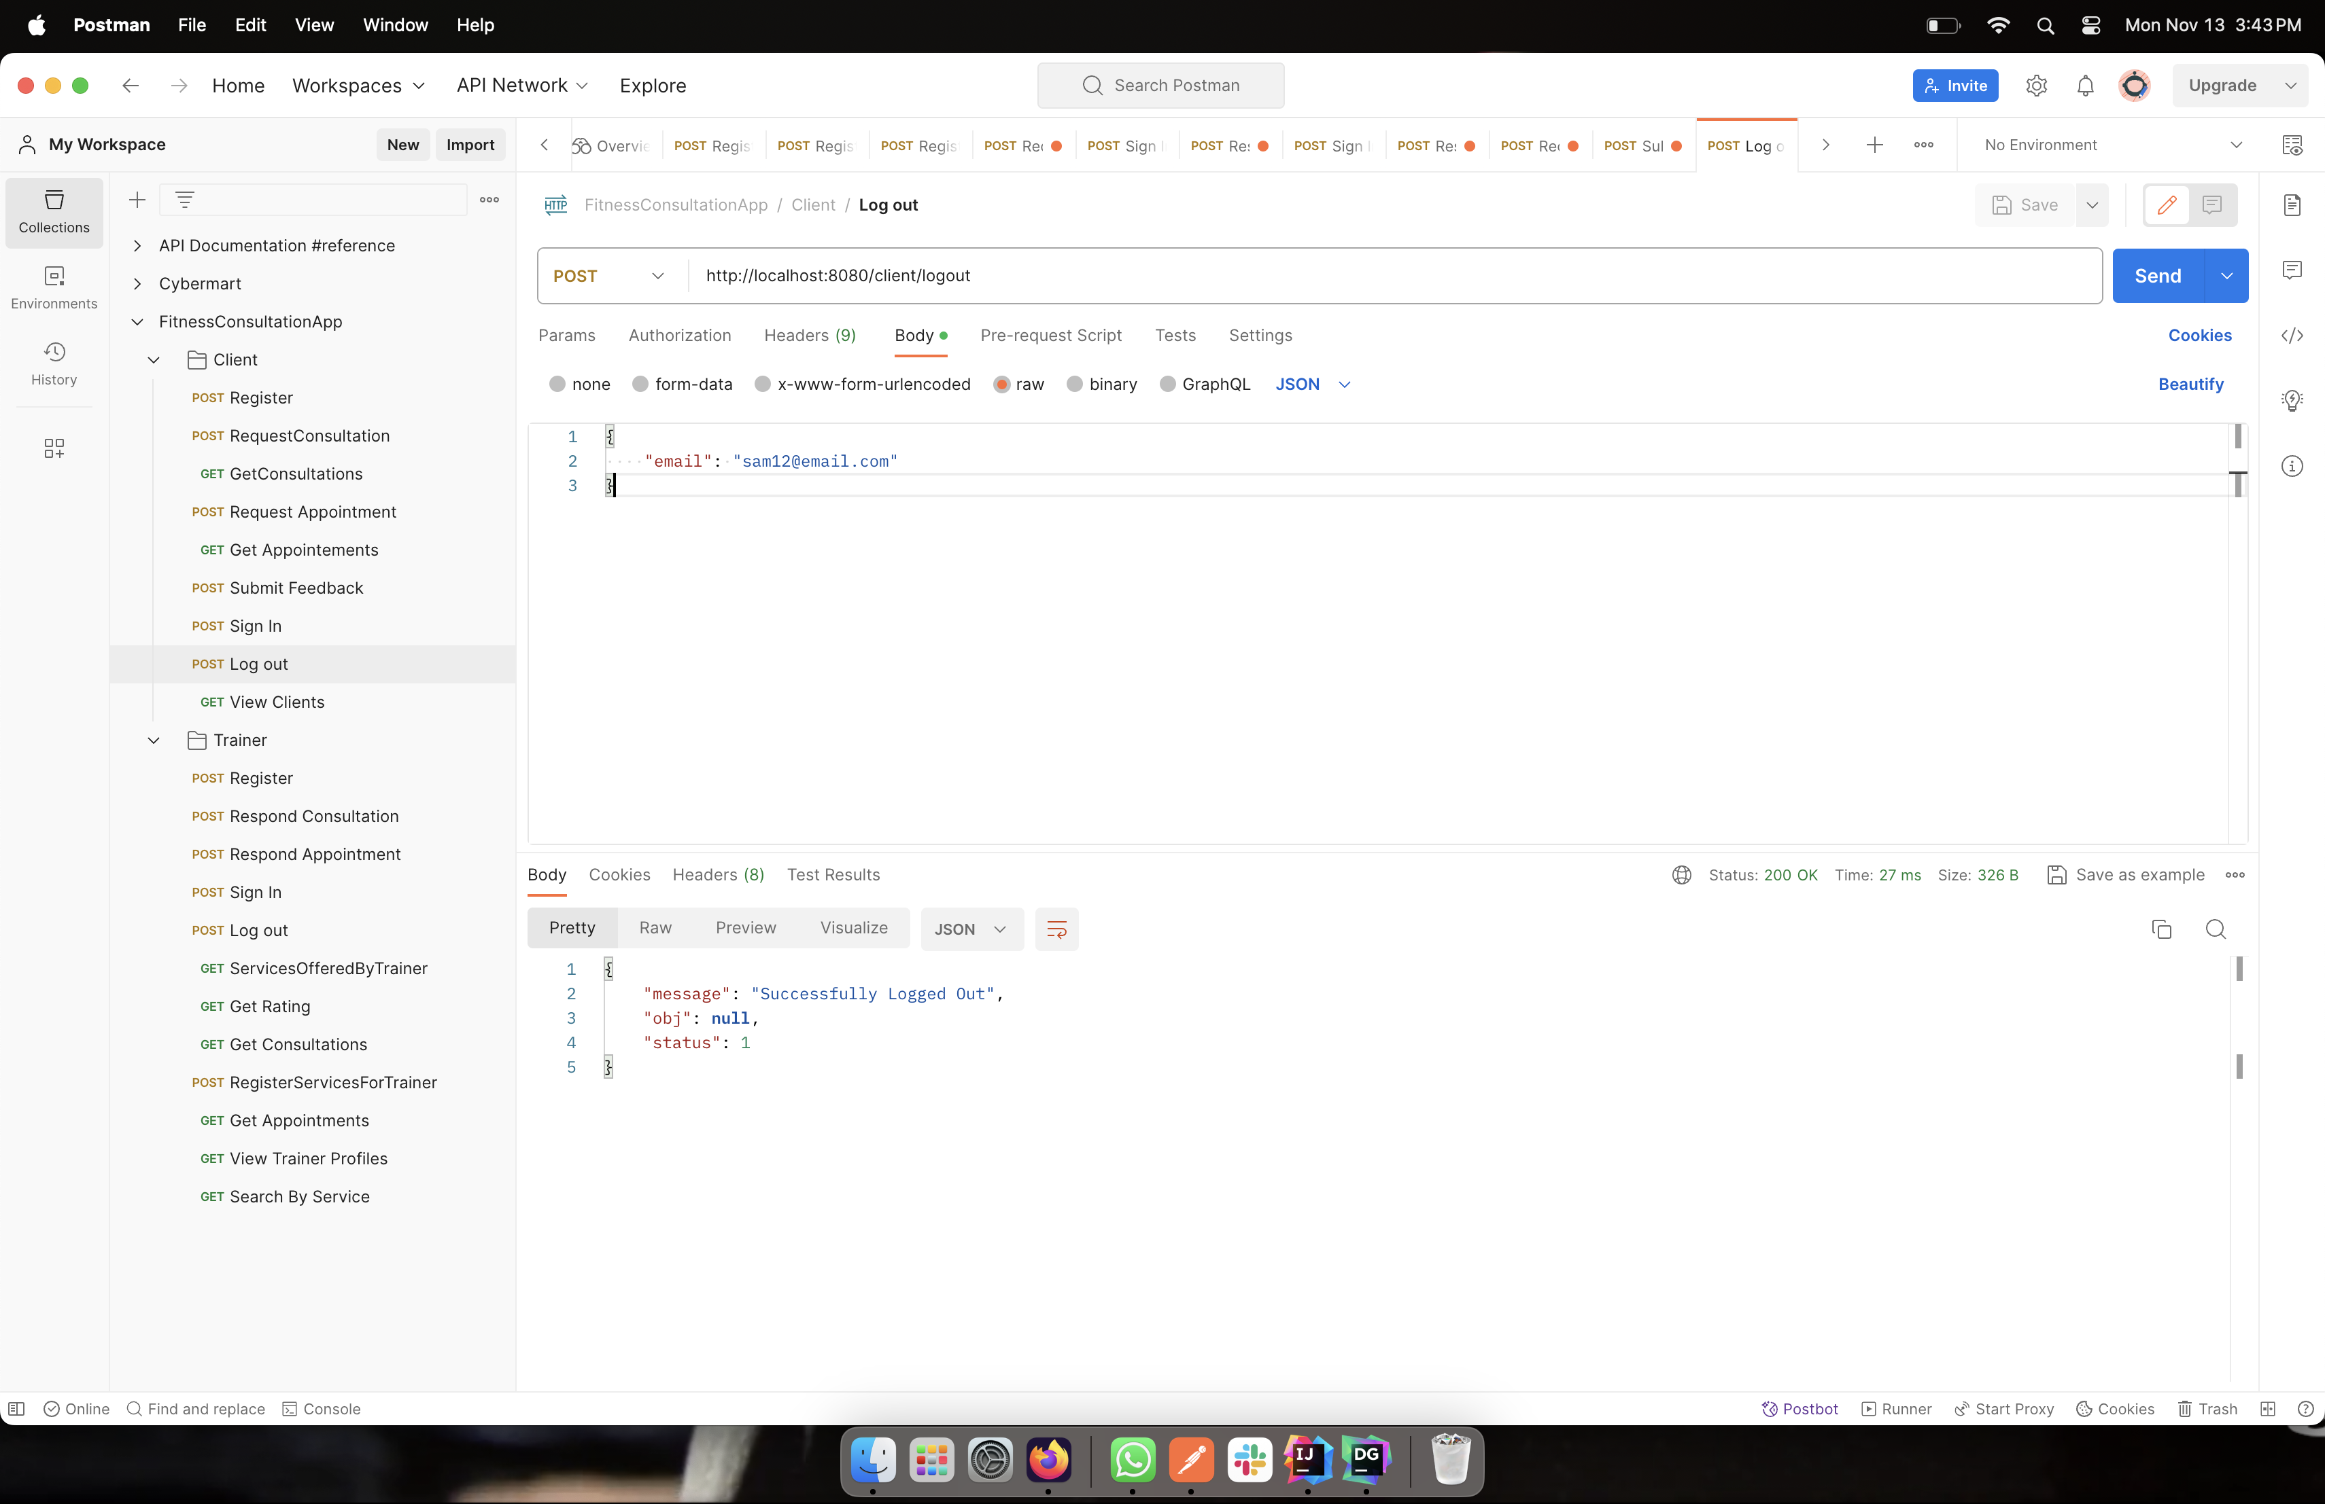
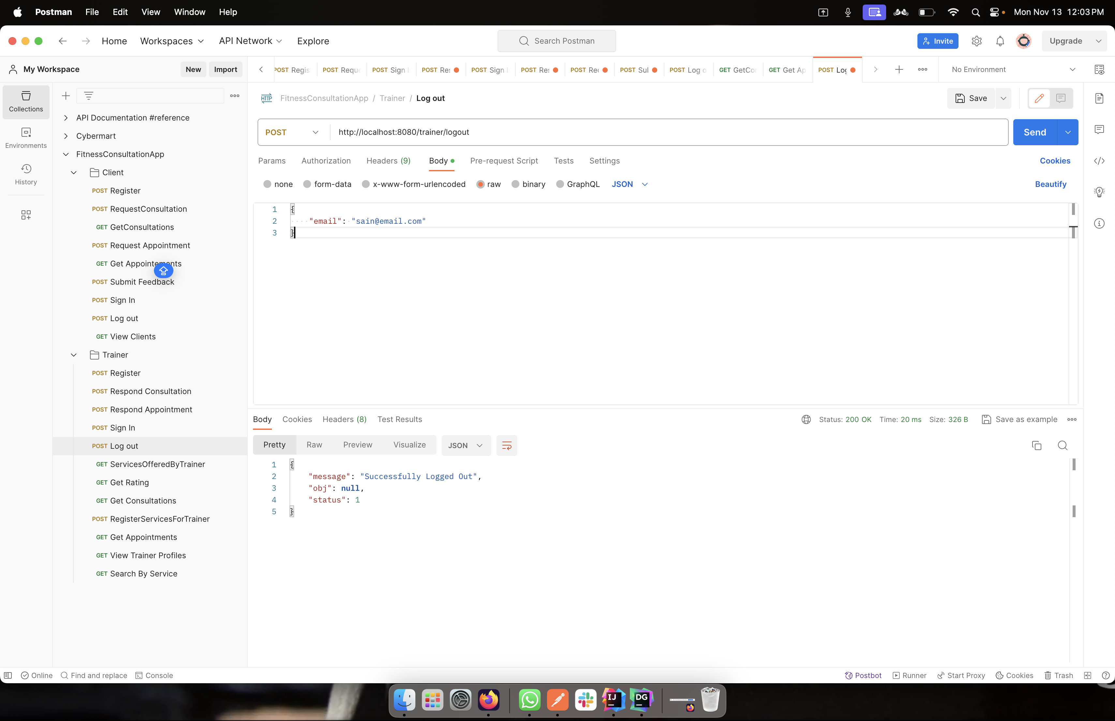
logout
After the relevant procedures have been performed, both the customer and the trainer can log out.

Slide 25


